Slide 1
Web Development Course-3

Slide 2

Teachback

Slide 3
Quote

Slide 4
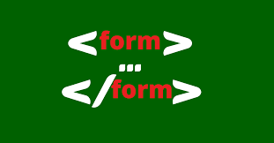
Forms
An HTML form is used to collect user input. The user input is most often sent to a server for processing.
The HTML <form> element is used to create an HTML form for user input:
The <form> element is a container for different types of input elements, such as:
text fields, checkboxes, radio buttons, submit buttons, etc.

Slide 5
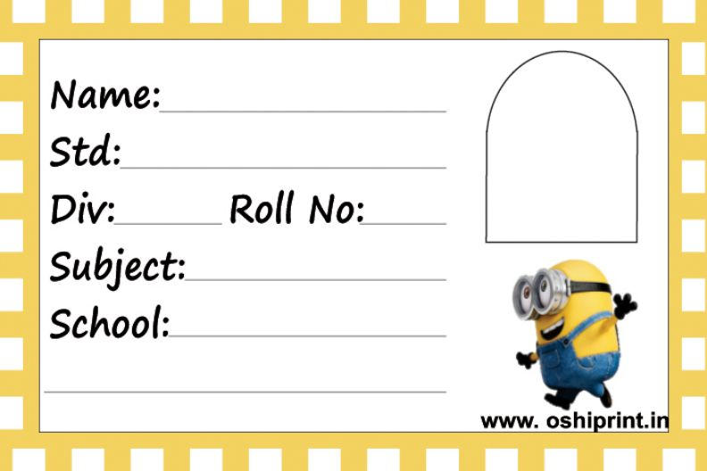
Quote
<label> Element
The <label> Element
Notice the use of the <label> element in the example above.
The <label> tag defines a label for many form elements.
The <label> element is useful for screen-reader users, because the screen-reader will read out loud the label when the user focuses on the input element.
The <label> element also helps users who have difficulty clicking on very small regions (such as radio buttons or checkboxes) - because when the user clicks the text within the <label> element, it toggles the radio button/checkbox.
The for attribute of the <label> tag should be equal to the id attribute of the <input> element to bind them together.

Slide 6
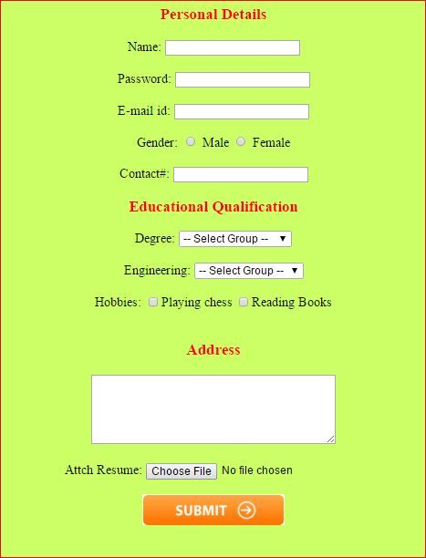
Forms
The <input> Element
The HTML <input> element is the most used form element.
An <input> element can be displayed in many ways, depending on the type attribute.
Here are some examples:
<input type="text">
<input type=“password">

Slide 7
Form-Inputs
<input type=" radio">
<input type=“checkbox">
<input type=“submit">
<input type=“button">
<input type=“email">
<input type=“number">
<input type=“url">
<input type=“search">
<input type=“tel">

Slide 8
Form-Inputs
<input type=“date ">
<input type=“resume”> don’t use
<input type=“image”> don’t use
<input type=“hidden”> don’t use
Others:
<textarea> </textarea>
<select>
<option> </option>
<option> </option>
</select>

Slide 9
Form-Attributes
The Action Attribute
The action attribute defines the action to be performed when the form is submitted.
Usually, the form data is sent to a file on the server when the user clicks on the submit button.
In the example below, the form data is sent to a file called "action_page.php". This file contains a server-side script that handles the form data:
<form action="/action_page.php">
The Target Attribute
The target attribute specifies where to display the response that is received after submitting the form.
The target attribute can have one of the following values:
<form action=“validate.php" target="_blank">

Slide 10
Form-Attributes
The Autocomplete Attribute
The autocomplete attribute specifies whether a form should have autocomplete on or off.
When autocomplete is on, the browser automatically complete values based on values that the user has entered before.
<form action="/action_page.php" autocomplete="on">
The Method Attribute
The method attribute specifies the HTTP method to be used when submitting the form data.
The form-data can be sent as URL variables (with method="get") or as HTTP post transaction (with method="post").
The default HTTP method when submitting form data is GET.
<form action="/action_page.php" method="get">

Slide 11
Form Input-Attributes
Label:
TYPE=“”
ID=“”
CLASS=“”
FOR=“”
NAME=“”
VALUE=“”
REQUIRED
SELECT - SELECTED ,SIZE,MULTIPLE

Slide 12
Form Input-Attributes
Label:
What is a label and example?
a slip (as of paper or cloth) inscribed and affixed to something for identification or description

